Slide 1


What Is Velocity?
Velocity is the amount of work completed each sprint.
It is measured by adding the sizes of the PBIs that are completed by the end of the sprint.
A PBI is either done or it’s not done.
The product owner doesn’t get any value from undone items, so velocity does not include the size numbers of partially completed PBIs.

Slide 2

What Is Velocity? (contd.)
Velocity measures output (the size of what was delivered), not outcome (the value of what was delivered).
We assume that if the product owner has agreed that the team should work on a PBI, it must have some value to him.
However, completing a PBI of size 8 doesn’t necessarily deliver more business value than completing a PBI of size 3.
Perhaps the PBI of size 3 is high value and therefore we work on it early (because it is high value and low cost), and we work on the PBI of size 8 later (because it is lower value and higher cost).

Slide 3

What Is Velocity? (contd.)
Velocity is used for two important purposes.
First, it is an essential concept for Scrum planning.
For release-level planning, we divide the size of the release by the team’s average velocity to calculate the number of sprints necessary to complete the release.
Additionally, at sprint planning, a team’s velocity is used as one input to help determine its capacity to commit to work during the upcoming sprint.

Slide 4

What Is Velocity? (contd.)
Second, velocity is also a diagnostic metric that the team can use to evaluate and improve its use of Scrum to deliver customer value.
By observing its own velocity over time, the team can gain insight into how specific process changes affect the delivery of measurable customer value.

Slide 5


Calculate a Velocity Range
For planning purposes, velocity is most useful when expressed as a range. Using a range allows us to be accurate without being overly precise.
“The team is typically able to complete between 25 and 30 points each sprint.”
it’s impossible to give a very precise answer. By using a range, we can communicate our uncertainty.

Slide 6
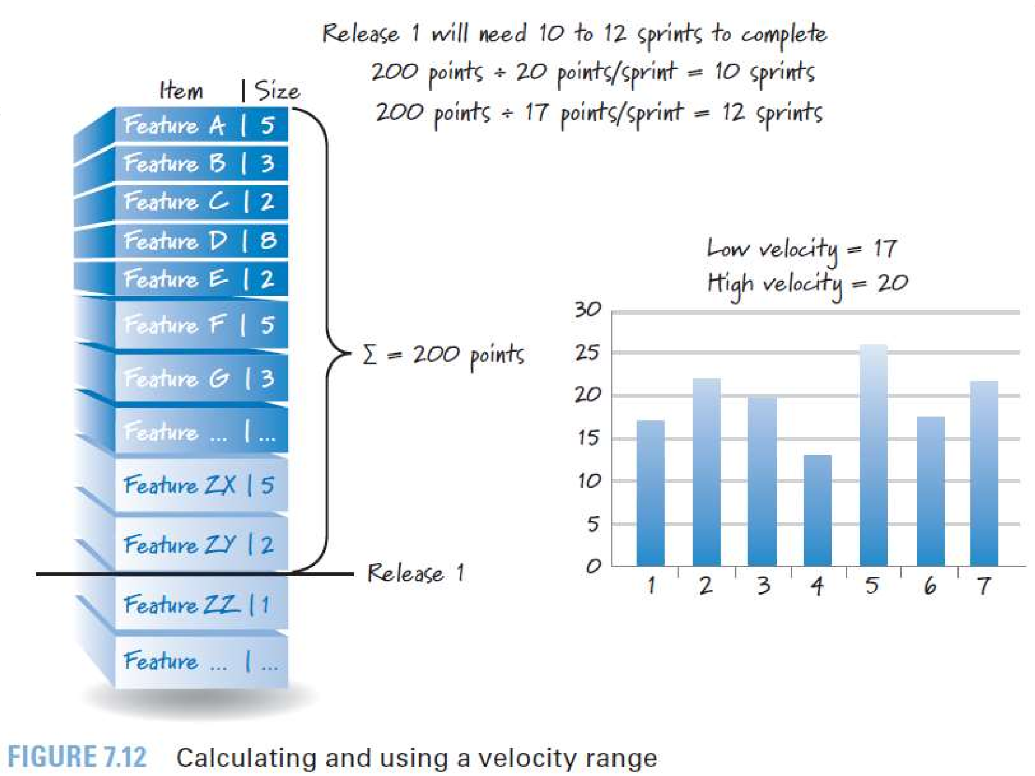



Slide 7
Forecasting Velocity
One of the benefits of having long lived teams is that they will acquire such useful historical velocity data that we could use to predict future velocity.
But how do we handle the situation where we have a new team whose members haven’t worked together and therefore have no historical data? We’ll have to forecast it.

Slide 8

Forecasting Velocity (contd.)
One common way to forecast a team’s velocity is to have the team perform sprint planning to determine what PBIs it could commit to delivering during a single sprint.
If the commitment seems reasonable, we would simply add the sizes of the committed PBIs and use that as the team’s forecasted velocity.
Because what we really want is a velocity range, we could have the team plan two sprints and use one estimated velocity number as the high and the other as the low (the two estimates would likely be different).

Slide 9
Forecasting Velocity (contd.)
Alternatively, we could make some adjustments to one estimated velocity based
intuitive
on
historical data for other teams, thereby converting the one estimate into a two-estimate range.
As soon as the team has performed a sprint and we have an actual velocity measurement, we should discard the forecast and use the actual.
And as the team builds up a history of actual velocities, we should compute averages or apply other statistics to the data to extract a velocity range.

Slide 10

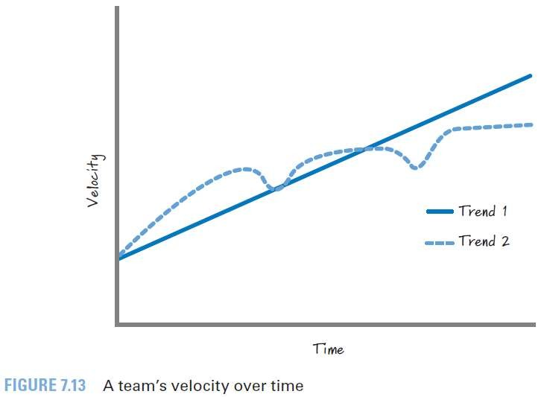
Affecting Velocity
Team’s velocity should constantly increase over time????

Slide 11

Affecting Velocity (contd.)
If the team is constantly inspecting
and adapting
(continuously improving), its velocity should keep getting better and better.
A team that is aggressively trying to improve itself and is focused on delivering features in accordance with a robust definition of done and low technical debt can see an increase in velocity. Well, at least an increase up to a certain point, at which time its velocity will likely plateau.

Slide 12
Affecting Velocity (contd.)
Just because a team’s velocity has leveled out doesn’t mean there is no more upward potential.
There are a number of ways that the Scrum team and managers can help get velocity to the next plateau.
For example, introducing new tools or increasing training can have a positive effect on velocity.
Or managers can strategically change team composition with the hope that the change will eventually lead to a greater overall velocity.

Slide 13
Affecting Velocity (contd.)
Of course, managers should be careful because haphazardly moving people on and off teams can and probably will cause velocity to decline.
Although introducing new tools, getting training, or changing team composition can have a positive effect on velocity, these actions usually cause a dip in velocity while the team absorbs and processes the change.
After this decline, there will probably be an increase to the point where the team establishes a new plateau until some other change causes yet another plateau to be achievable.

Slide 14

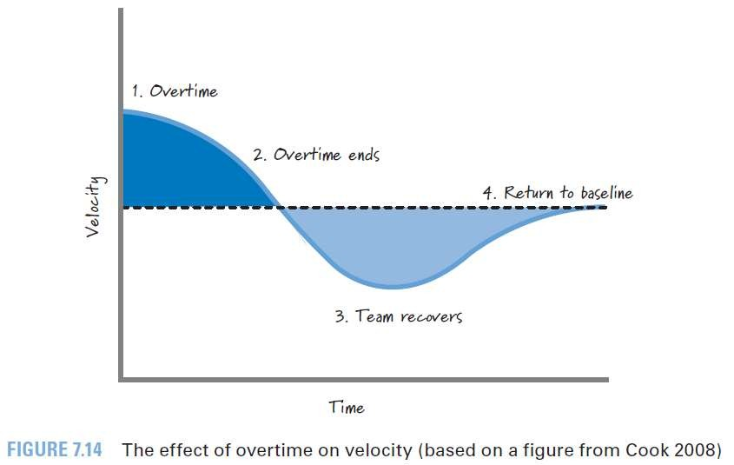
Affecting Velocity (contd.)
Of course, there is one obvious thing we could do to try to improve velocity: work longer hours.
Working a lot of consecutive overtime might initially cause velocity to increase.
That almost followed
increase will certainly be by an
in
aggressive
decline
velocity along with a simultaneous decline in quality.

Slide 15
Affecting Velocity (contd.)
Even after the overtime period ends, the team will need some amount of time to recover before returning to its reasonable baseline velocity.
Mostly the trough (decreased velocity area) during the recovery period is larger than the crest (increased velocity area) during the overtime period.
The end result is that lots of overtime may provide some short-term benefits, but these are frequently far outweighed by the long-term consequences.

Slide 16

Misusing Velocity
Velocity is used as a planning tool and as a team diagnostic metric.
It should not be used as a performance metric in an attempt to judge team productivity.
When misused in this way, velocity can motivate wasteful and dangerous behavior.
For example, say We have decided to give the largest bonus to the team that has the highest velocity.
Superficially this idea might seem sensible; the team with the highest velocity must be getting the most work done each sprint, right? So, why not reward that behavior?

Slide 17

Misusing Velocity (contd.)
Well, if I’m comparing teams that aren’t sizing their PBIs using a common baseline (which is very likely true), comparing the numbers would make no sense.
Let’s say that team A assigns a value of 5 to a PBI, whereas team B assigns a value of 50 to the same PBI.
Team A doesn’t really want me to compare its velocity against team B’s velocity.
Team B’s velocity will be ten times that of team A, even if both teams actually get about the same quantity of work completed each sprint.

Slide 18

Misusing Velocity (contd.)
Once team A sees the problem, its members will start to game the system to ensure that their velocity numbers are higher.
The easy way to do this is to just change the scale the team uses to estimate PBIs.
So, team A now sizes the same item (the one it originally sized a 5) to be a 500.
We call this behavior point inflation, and it serves no purpose other than to align a team’s behavior with a misguided measurement system.
Don’t do this.

Slide 19

Misusing Velocity (contd.)
If we set up the reward system to favor bigger numbers, that’s exactly what I’ll get—bigger numbers (point inflation).
Even worse than point inflation is when teams cut corners to get more “done” in an effort to achieve higher, more desirable velocities. Doing so leads to increasingly greater levels of technical debt.
At the end of the day, we should judge velocity on how well it assists us with performing accurate planning and how well it helps a team to internally improve itself.
Any other uses will likely promote the wrong behavior.

